Slide 1

Linux Command implementation in C
Diff Command
Name- Shreeraj Bhamare , MIS - 111903098

Slide 2
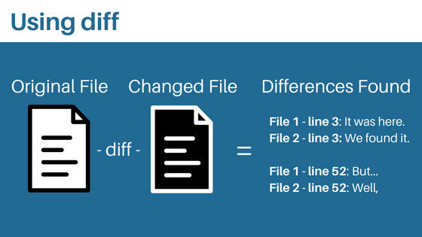
Diff- Command
Syntax :
diff [options] File1 File2
Special symbols are :
a : add
c : change
d : delete
Name- Shreeraj Bhamare , MIS - 111903098

Slide 3
Modes implemented
Context Mode (-c)
Unified Mode (-u)
Non Case sensitive Mode (-i)
All types of White Space ignorance Mode (-w)
Ignore Changes in the amount of white space Mode (-b)
Reporting that files are different Mode (-q)
Reporting that files are Identical Mode (-s)
Normal diff Mode (No need of attribute)
Name- Shreeraj Bhamare , MIS - 111903098

Slide 4
Algorithm
Abstract Data Type (ADT)
Longest Common Subsequence (LCS)
Memoization
Queue
Stack
File Handling
Singly Linked List
Name- Shreeraj Bhamare , MIS - 111903098

Slide 5
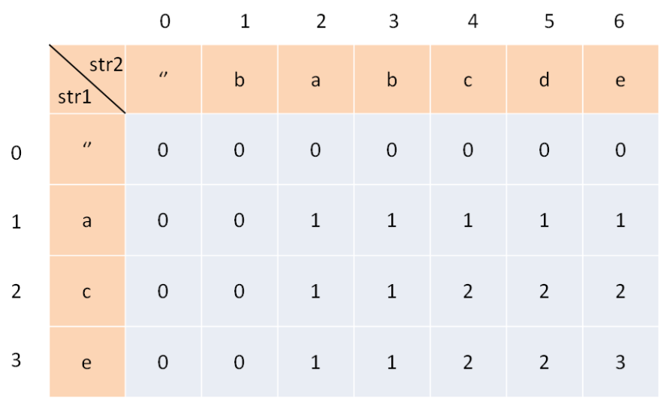
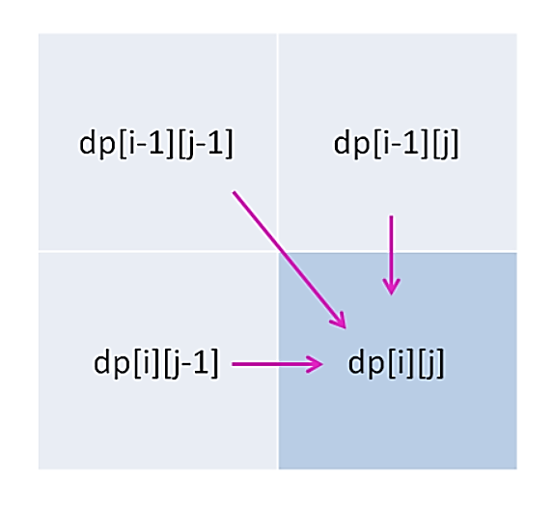

LCS - Overview
Algorithm: LCS-Length-Table-Formulation (X, Y) :
m := length(X)
n := length(Y)
for i = 1 to m do
C[i, 0] := 0
for j = 1 to n do
C[0, j] := 0
for i = 1 to m do
for j = 1 to n do
if xi = yj
C[i, j] := C[i - 1, j - 1] + 1
B[i, j] := ‘D’
else
if C[i -1, j] ≥ C[i, j -1]
C[i, j] := C[i - 1, j] + 1
B[i, j] := ‘U’
else
C[i, j] := C[i, j - 1]
B[i, j] := ‘L’
return C and B
Name- Shreeraj Bhamare , MIS - 111903098

Slide 6
LCS Analysis
n = Rows ; m = Column
Time Complexity
Worst case time complexity: O(n*m)
Average case time complexity: O(n*m)
Best case time complexity: O(n*m)
Space complexity: O(n*m)
Space Complexity
O(n*m)
Since this implementation involves only n rows and m columns for building dp[][],therefore, the space complexity would be O(n * m).
Name- Shreeraj Bhamare , MIS - 111903098

Slide 7
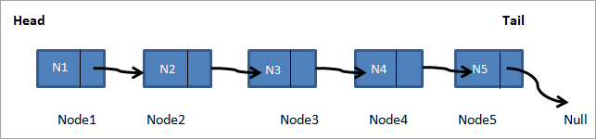
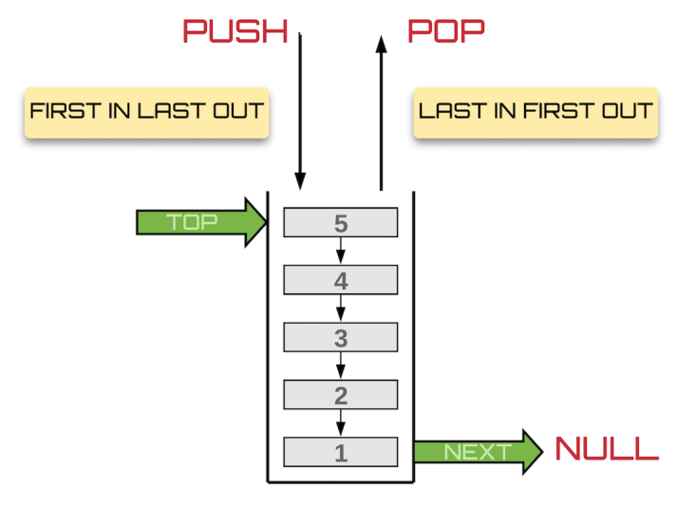
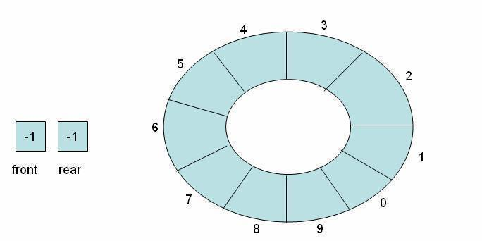
ADT Visualization
Singly Linked List
Stack
Circular Queue
Name- Shreeraj Bhamare , MIS - 111903098

Slide 8
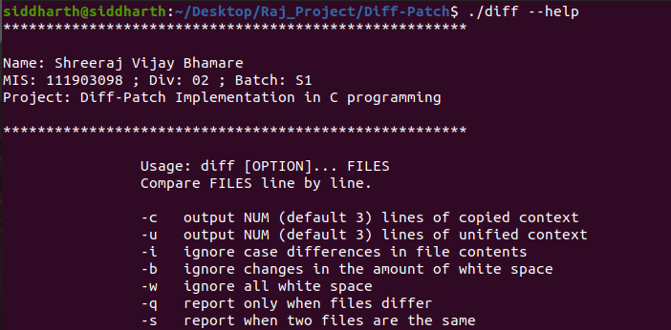
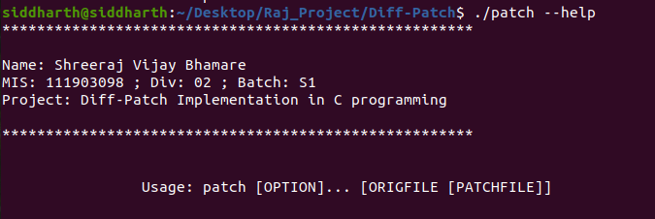
“--help” Attribute
Diff --help
Patch --help

Slide 9
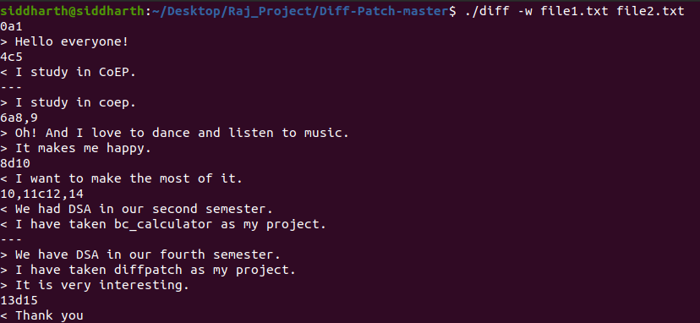
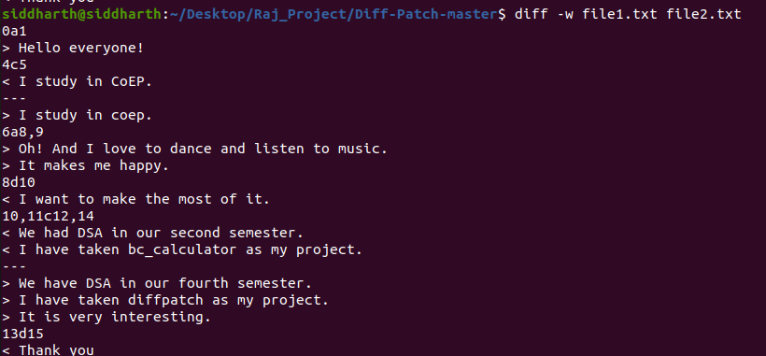
“-w” Comparison
Actual Output
Expected Output
Name- Shreeraj Bhamare , MIS - 111903098

Slide 10
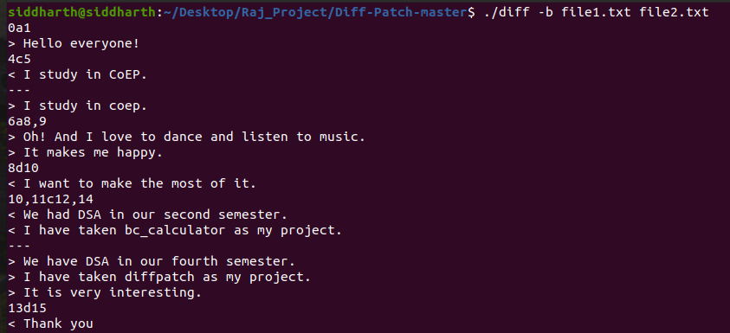
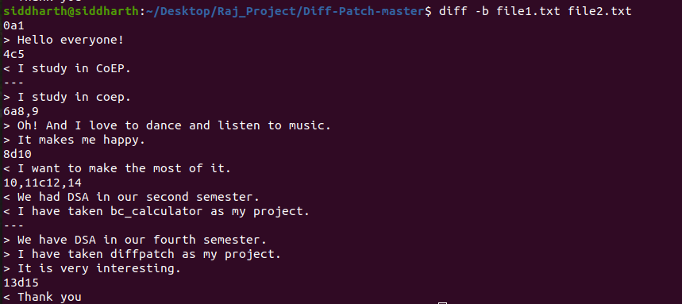
“-b” Comparison
Actual Output
Expected Output
Name- Shreeraj Bhamare , MIS - 111903098

Slide 11
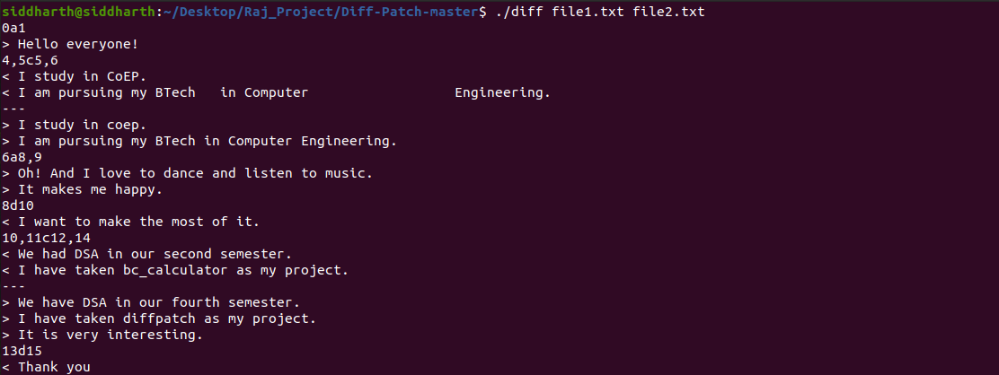
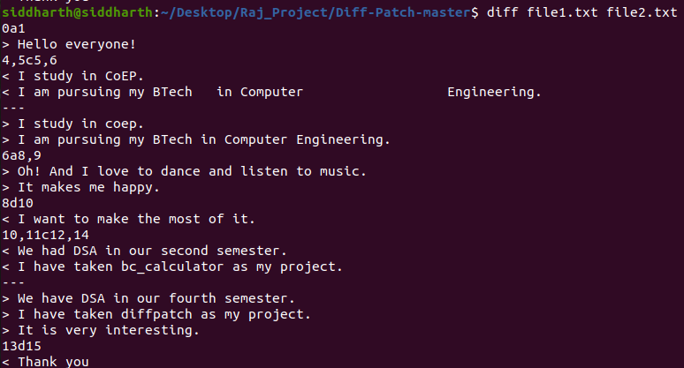
Normal diff Comparison
Actual Output
Expected Output
Name- Shreeraj Bhamare , MIS - 111903098

Slide 12
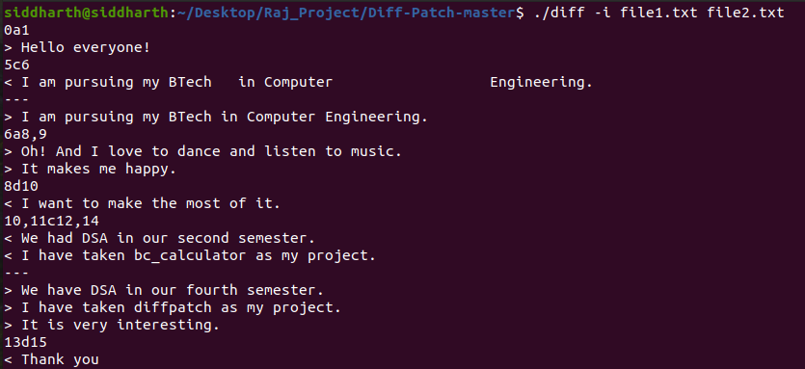
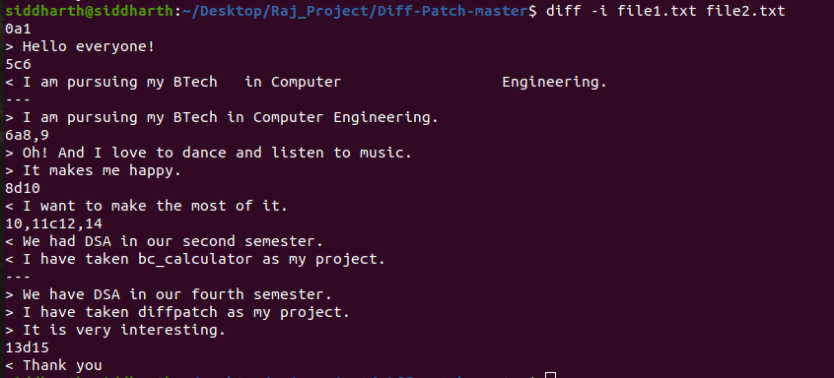
“-i” Comparison
Actual Output
Expected Output
Name- Shreeraj Bhamare , MIS - 111903098

Slide 13
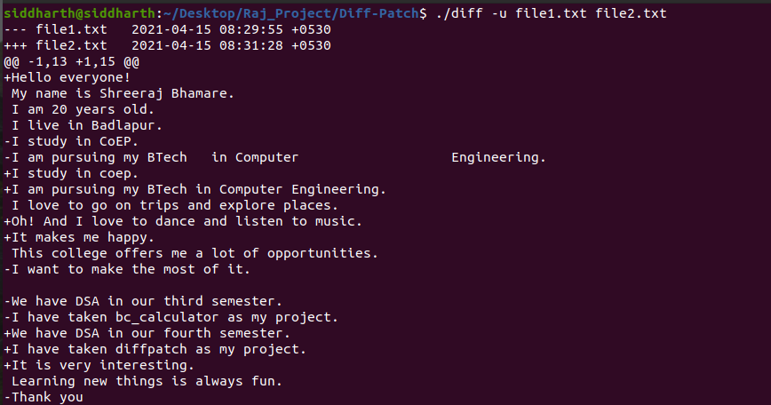
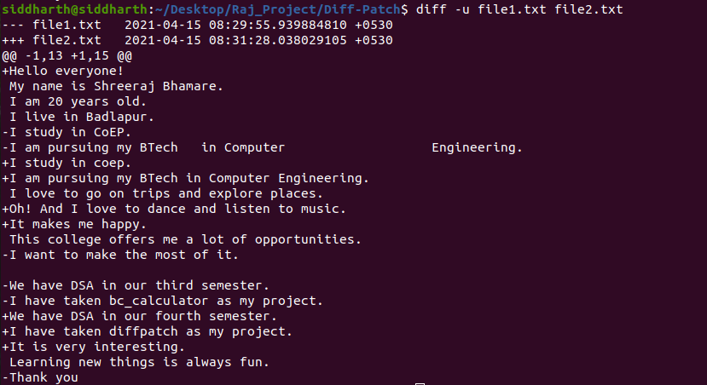
“-u” Comparison
Actual Output
Expected Output
Name- Shreeraj Bhamare , MIS - 111903098

Slide 14
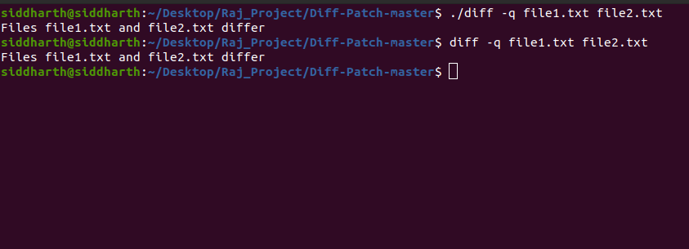
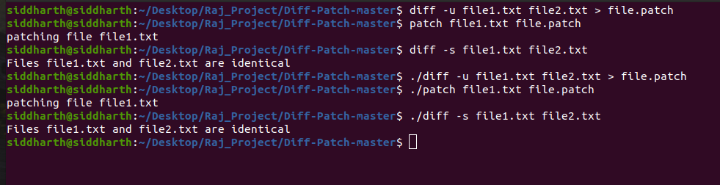
“-q” and Patch Comparison
“-q” Comparison
Patch and “–s” Comparison

Slide 15



